Slide 1

Gertie Games
Some tagline
Available Titles

Slide 2


Slide 3
Gertie, wake up!
You’ve gotta head down to Beckley
Park for your big day!

Slide 4
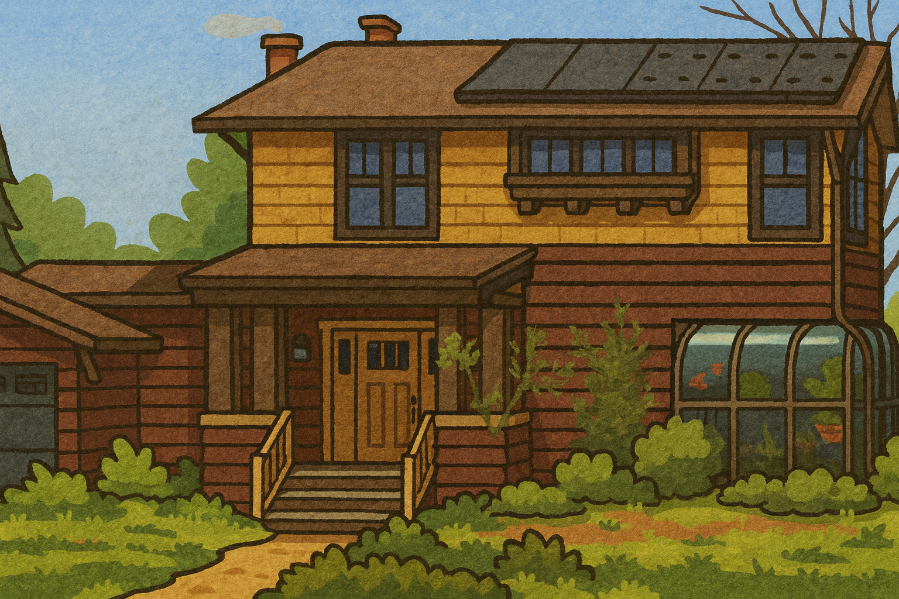
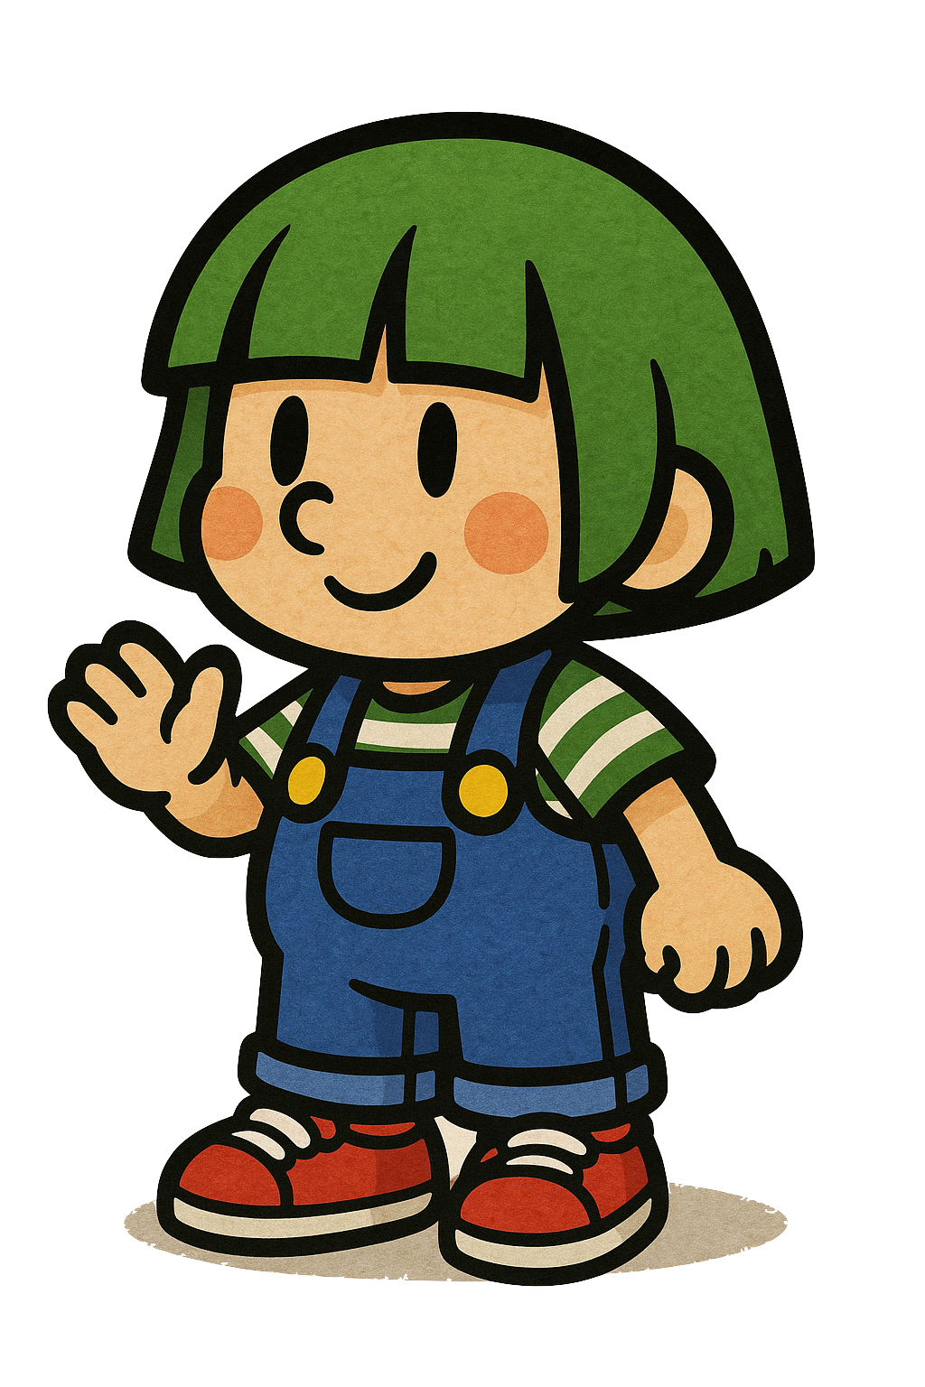


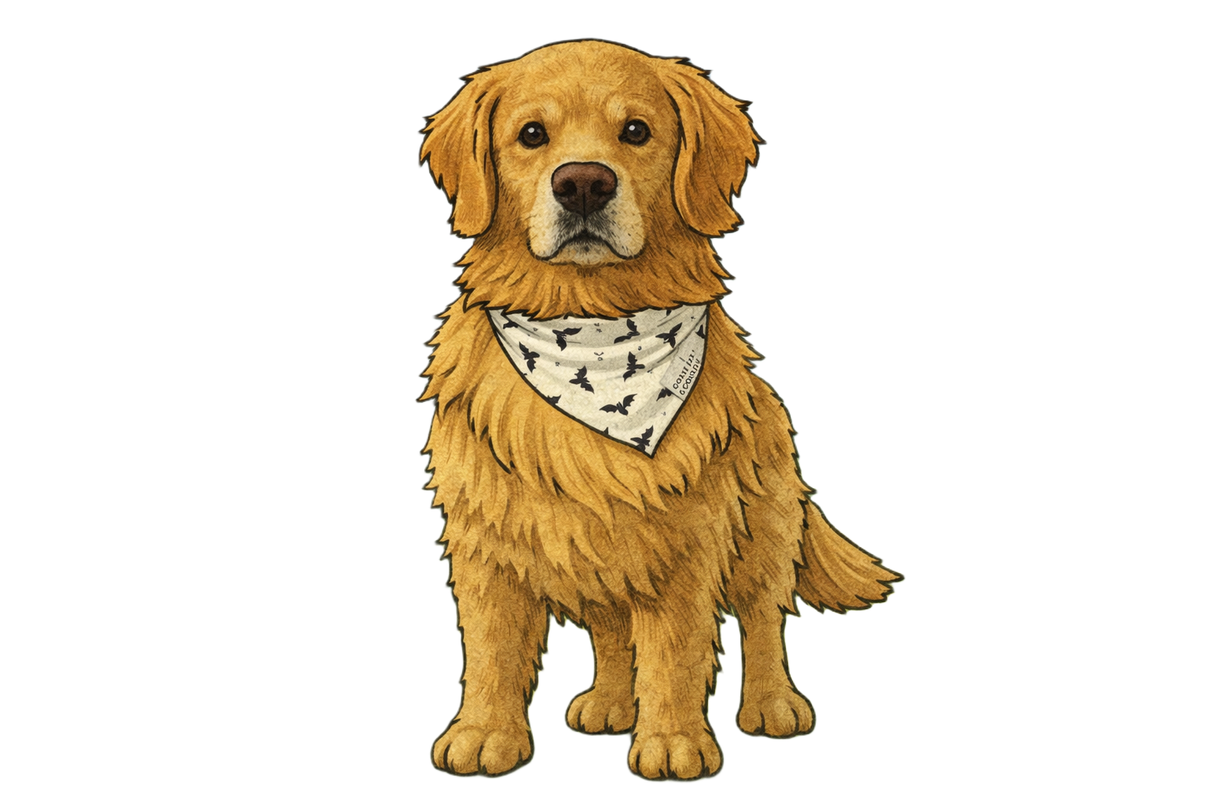


It’s Grandpa and the dogs!
“Gertie, I can’t remember how
many leashes I need, can you
help me count the dogs?”

Slide 5
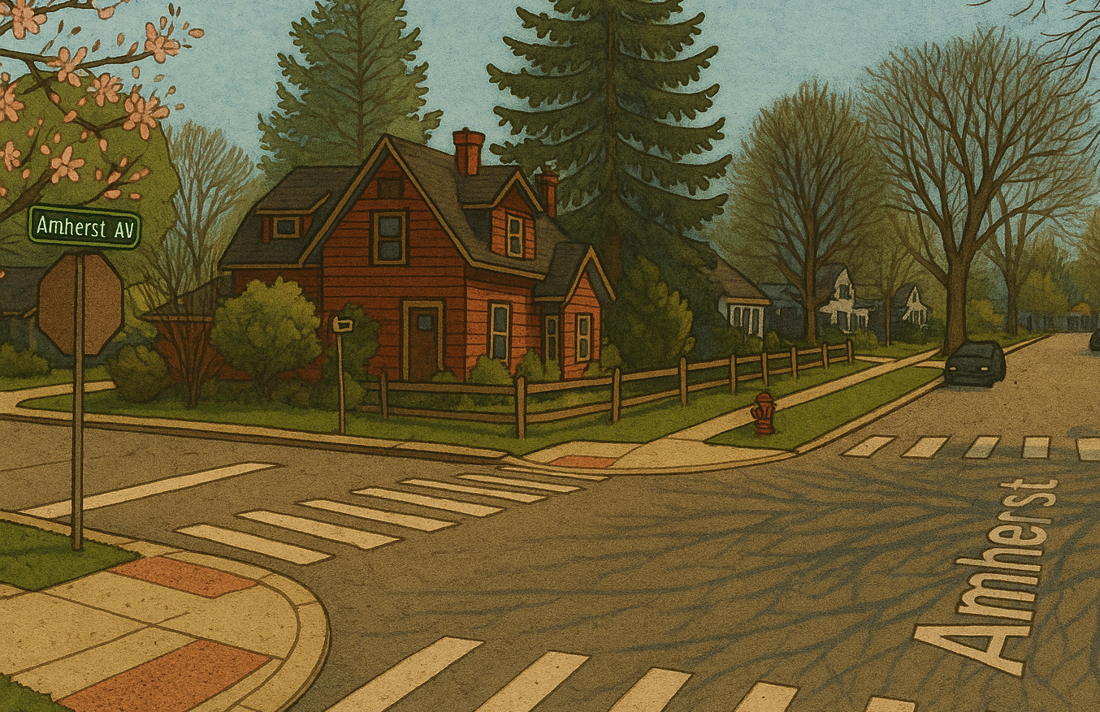
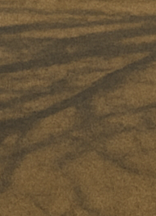
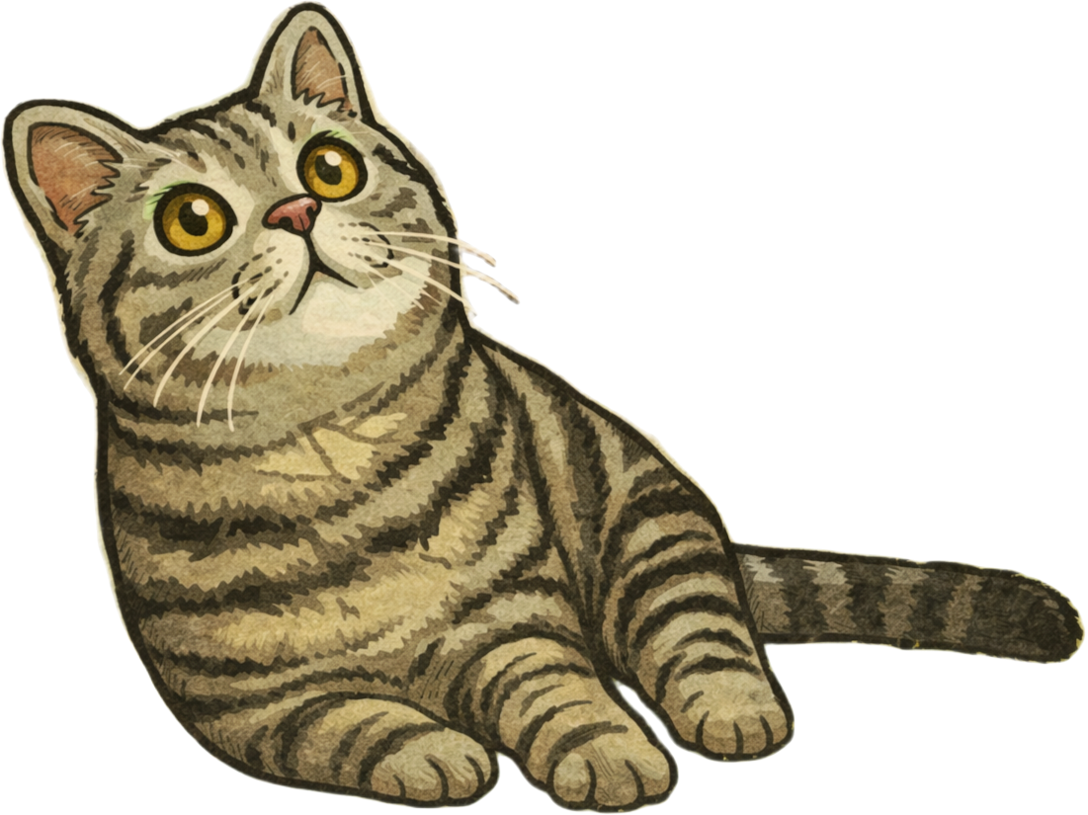
It’s Spike the cat!
Let’s pet Spike

Slide 6
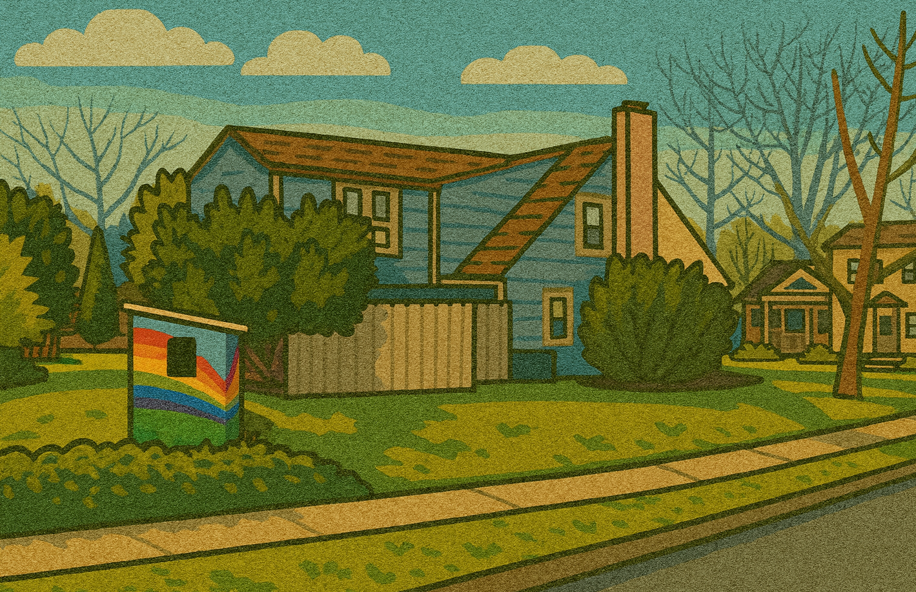


It’s the Kramer’s House!
They lost an egg, can you help them find it?

Slide 7
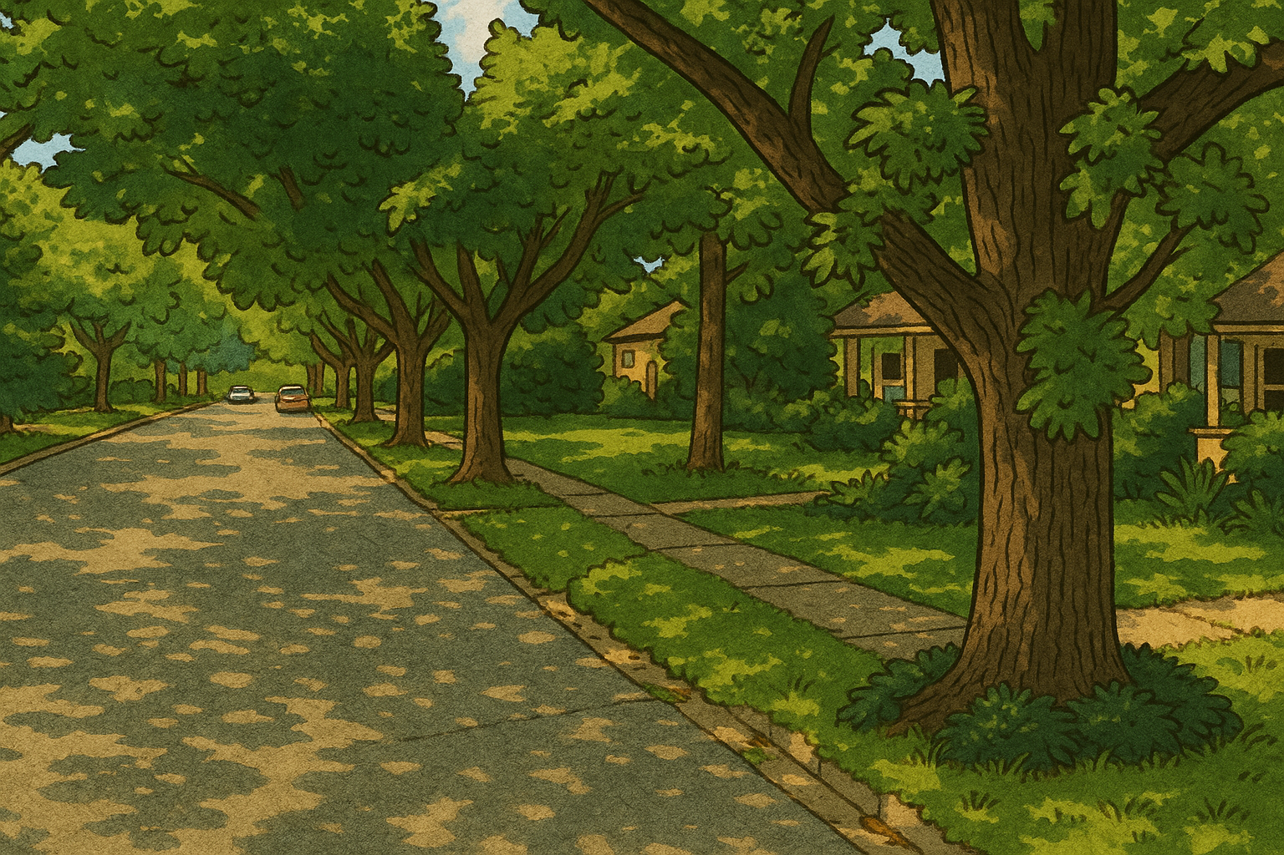
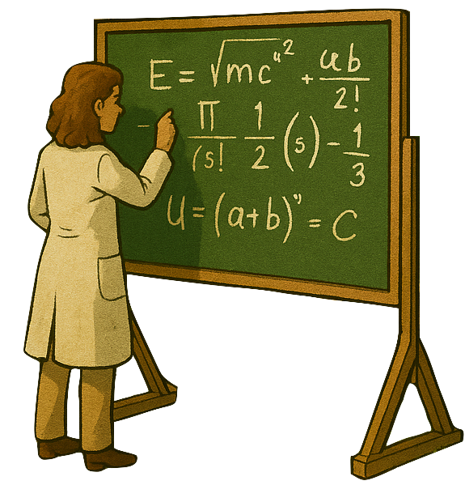

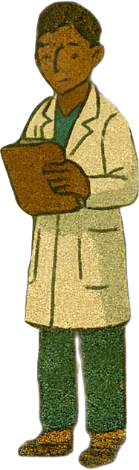




It’s Grandma and scientists!
“We’ve gotta study this cool mushroom.
Can you find another way around?”

Slide 8
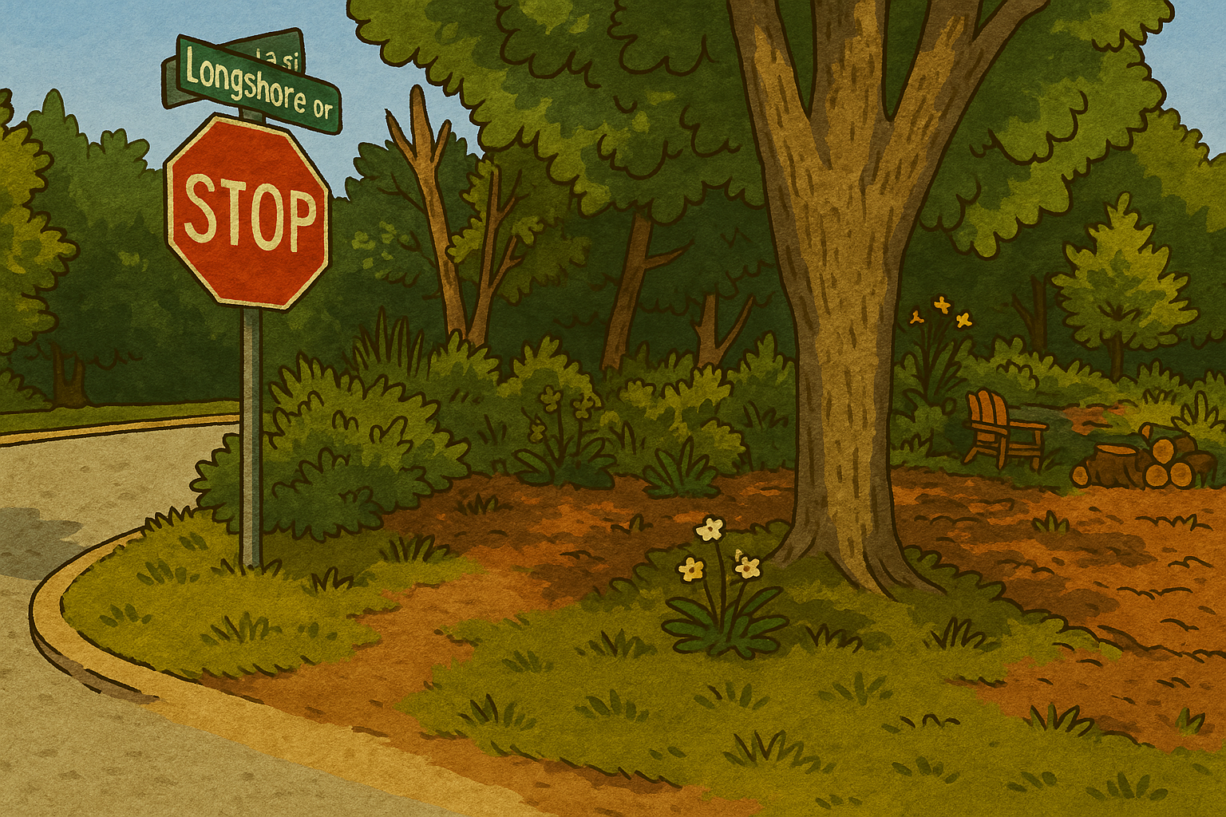



I think I see a skunk in the bushes!
Let’s watch out for that

Slide 9
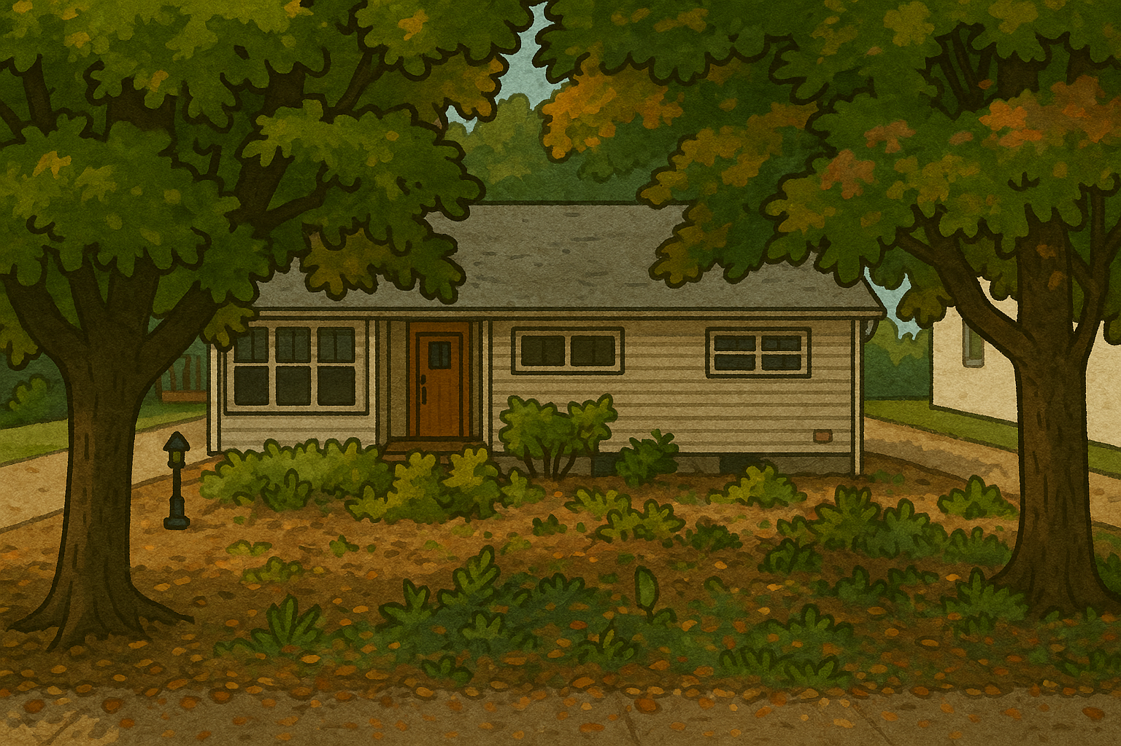

It’s Brooklyn!
He must have taken himself for a
walk down to his friend Hazel’s house

Slide 10
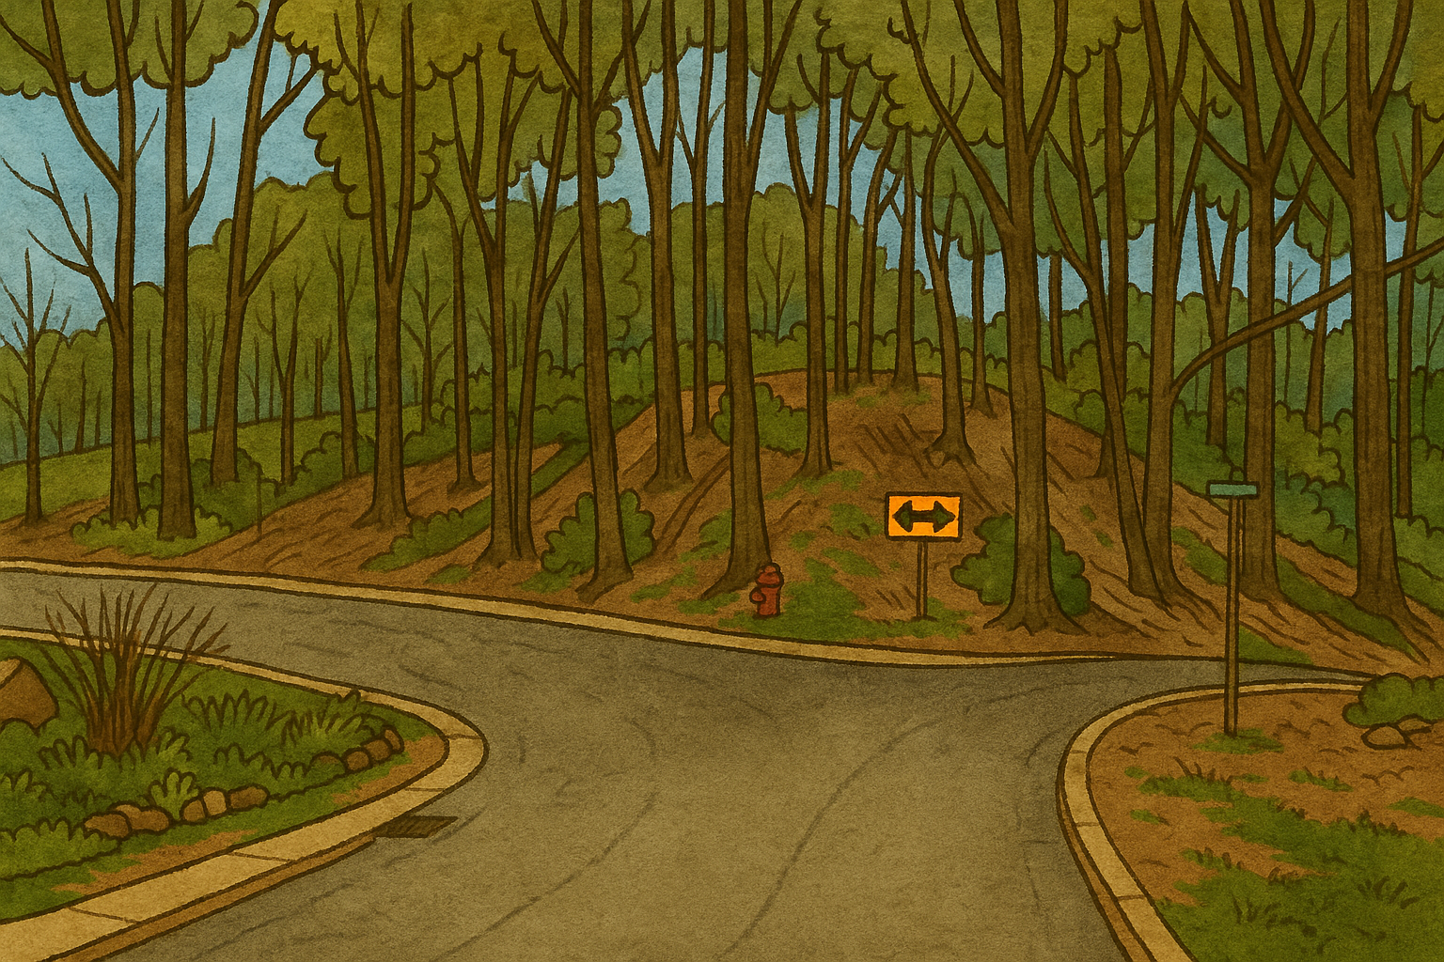

There’s a fork in the road!
I think I see some balloons out
to the left, though!
Party equipment

Slide 11
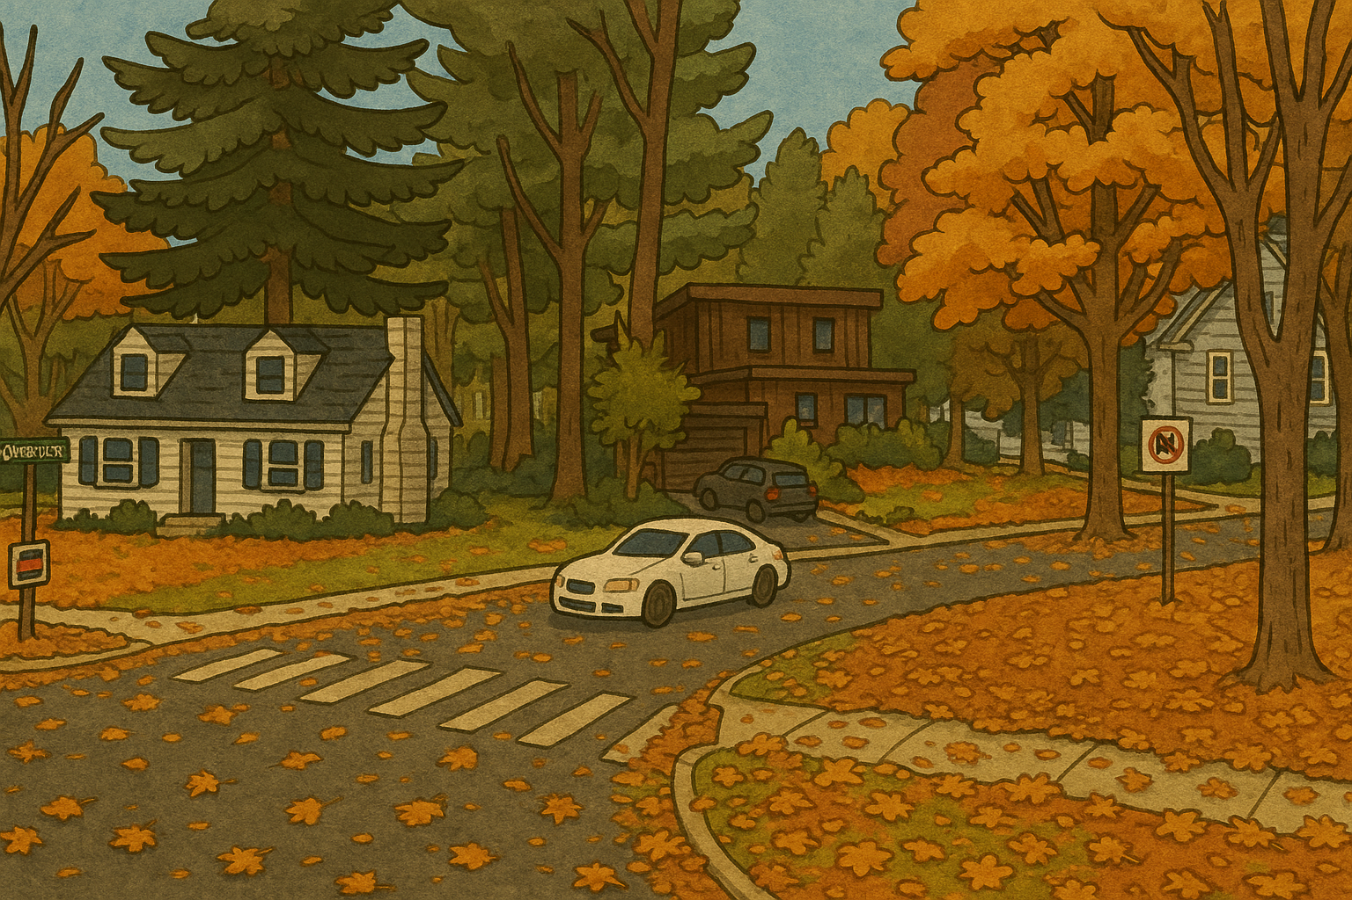


Aunt Marge is blowing up like a balloon!
Oh wait, that’s just a balloon of Aunt
Marge and Uncle Tommy is carrying it
down to the park!

Slide 12
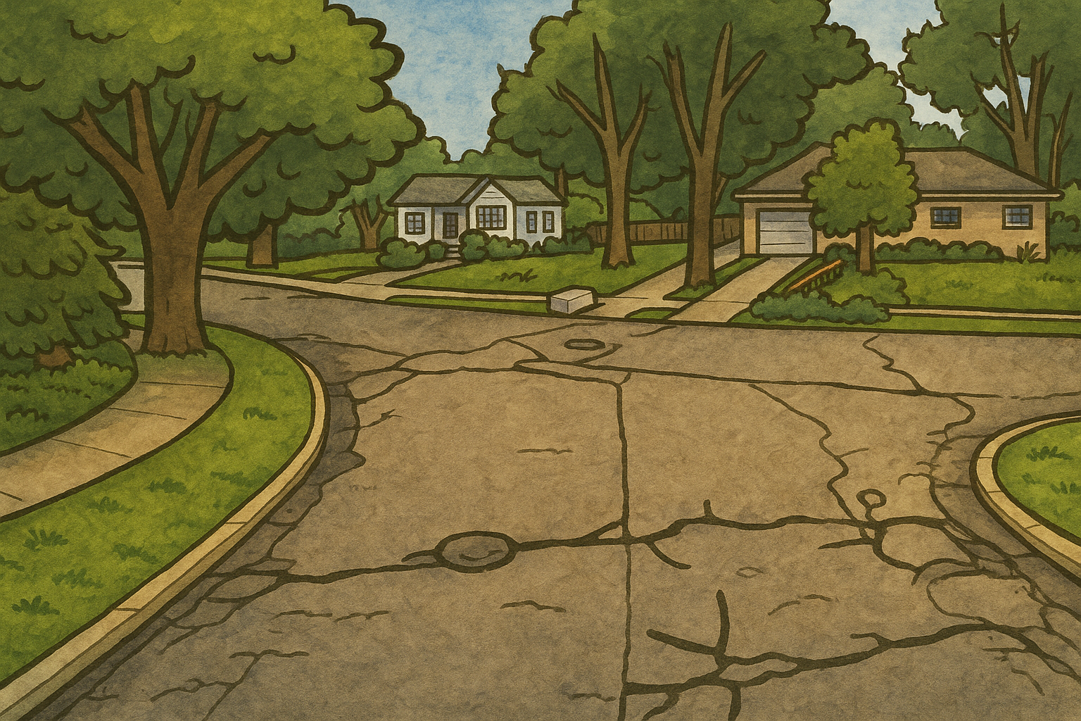
It’s Grandma and Grandpa with the dogs!
I guess they’re done studying the mushroom

Slide 13
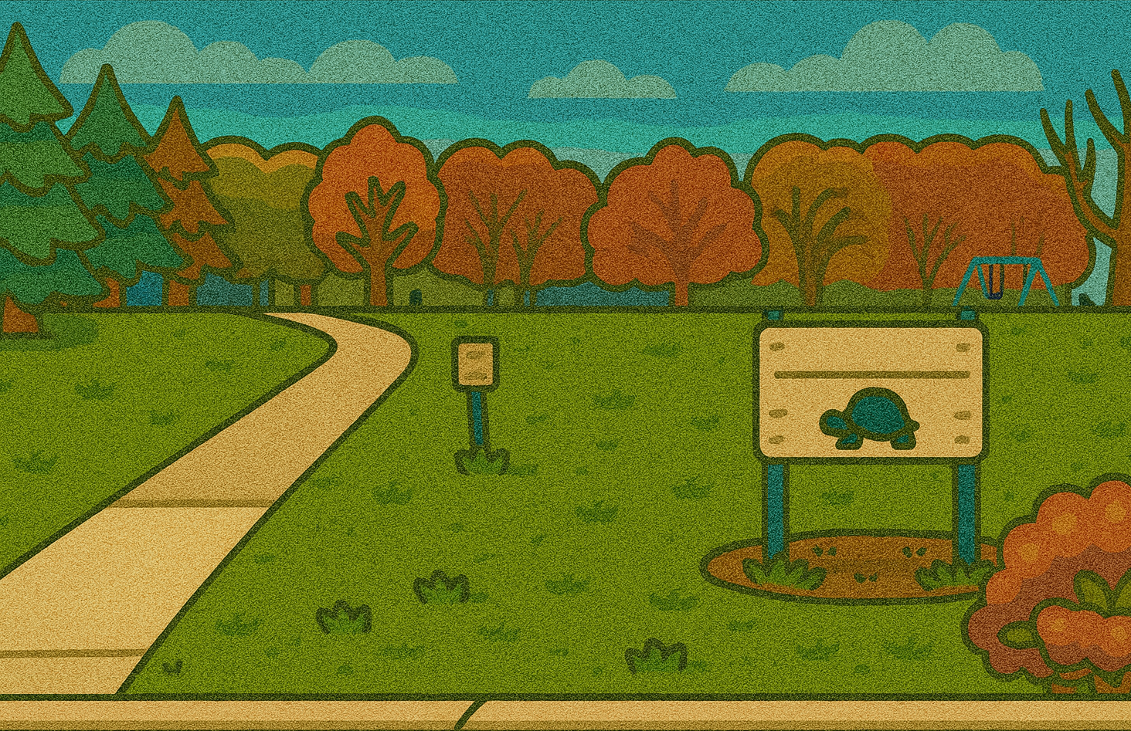



There are definitely balloons there!
Let’s go!

Slide 14
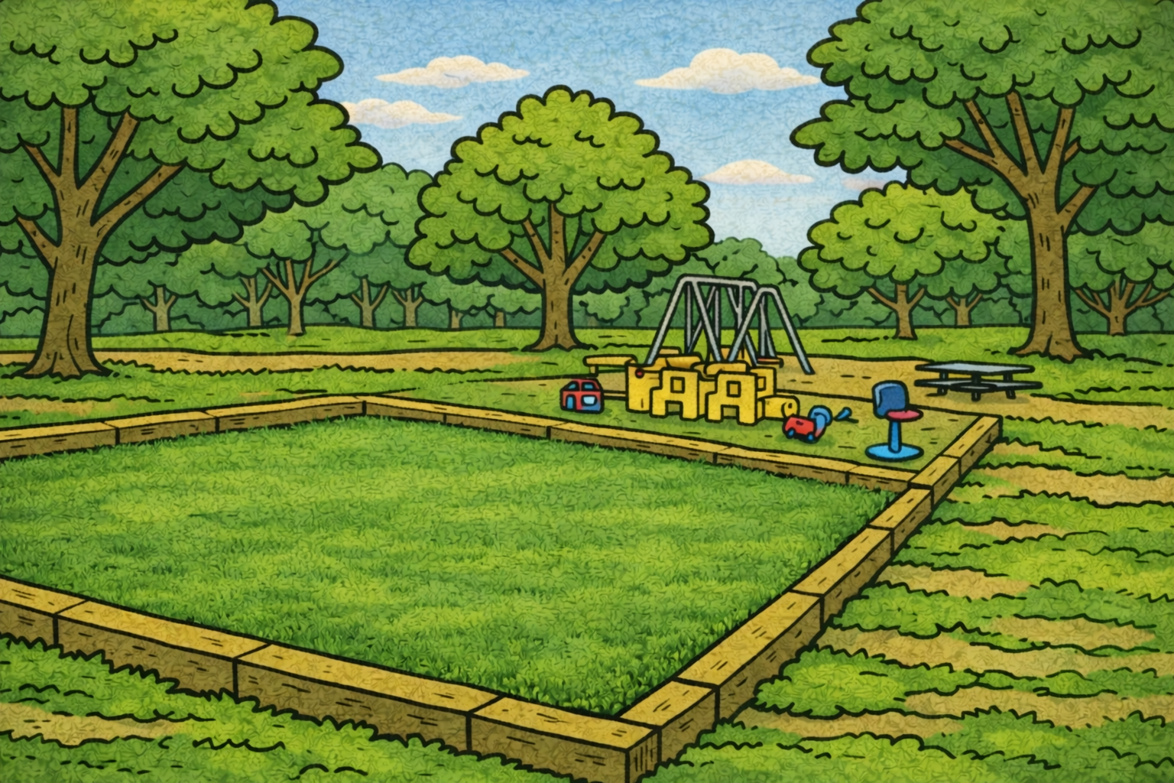
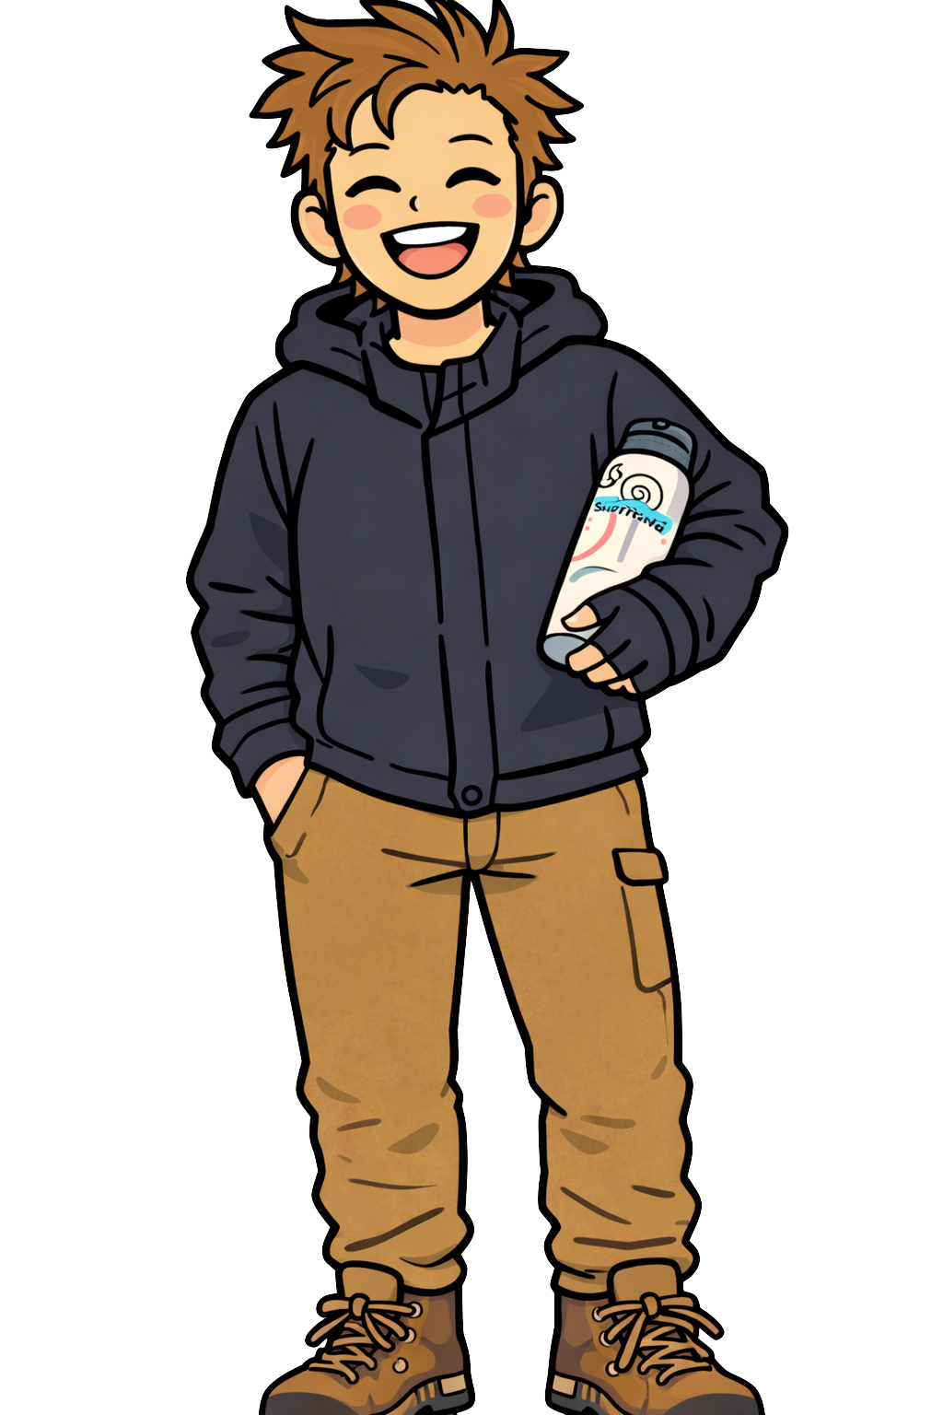
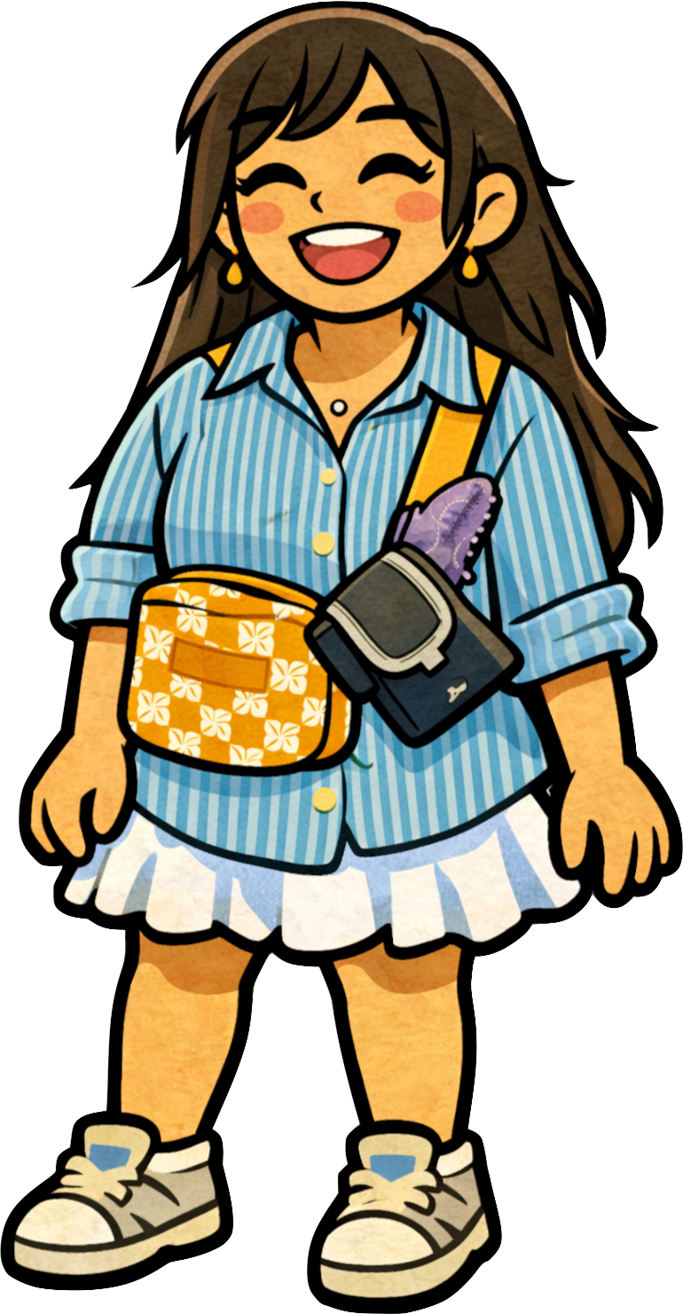
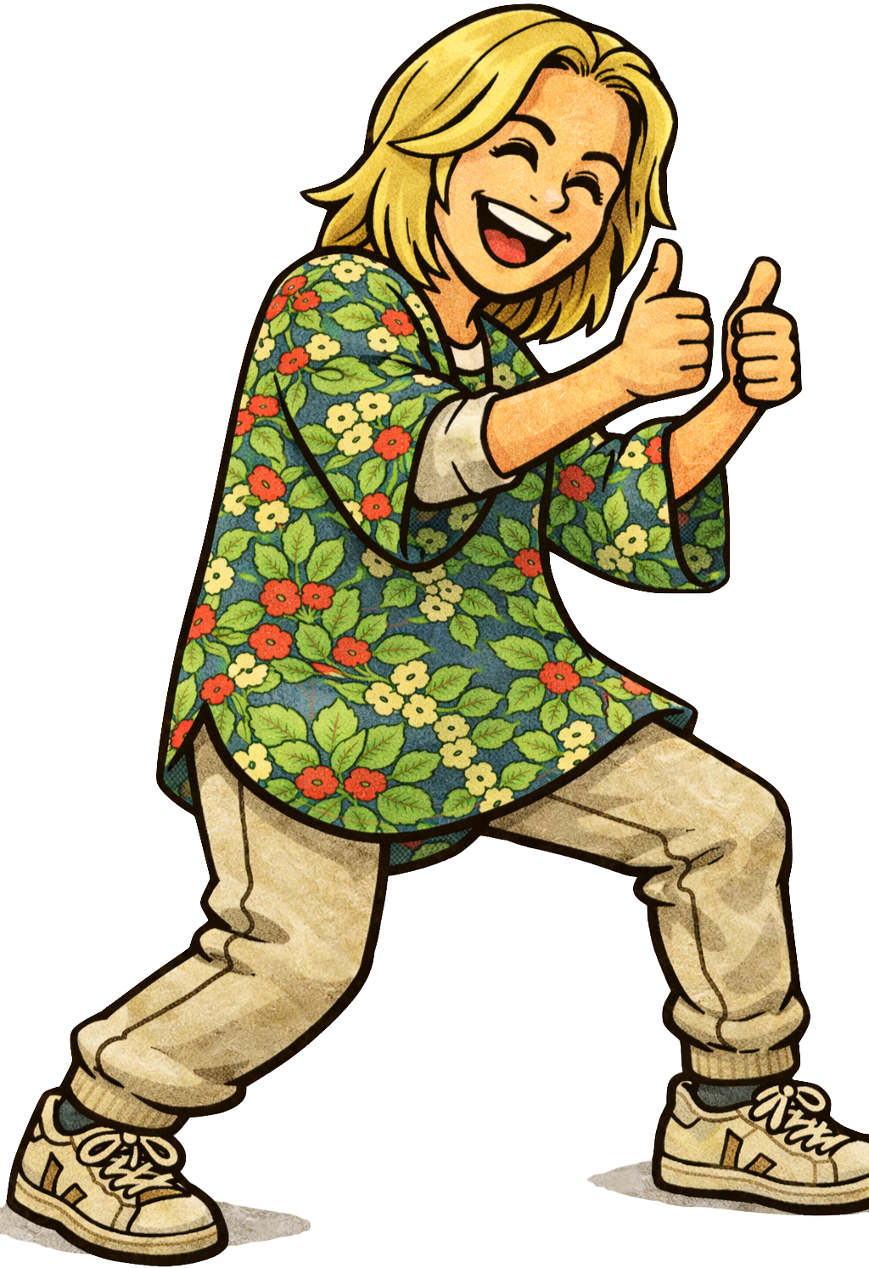
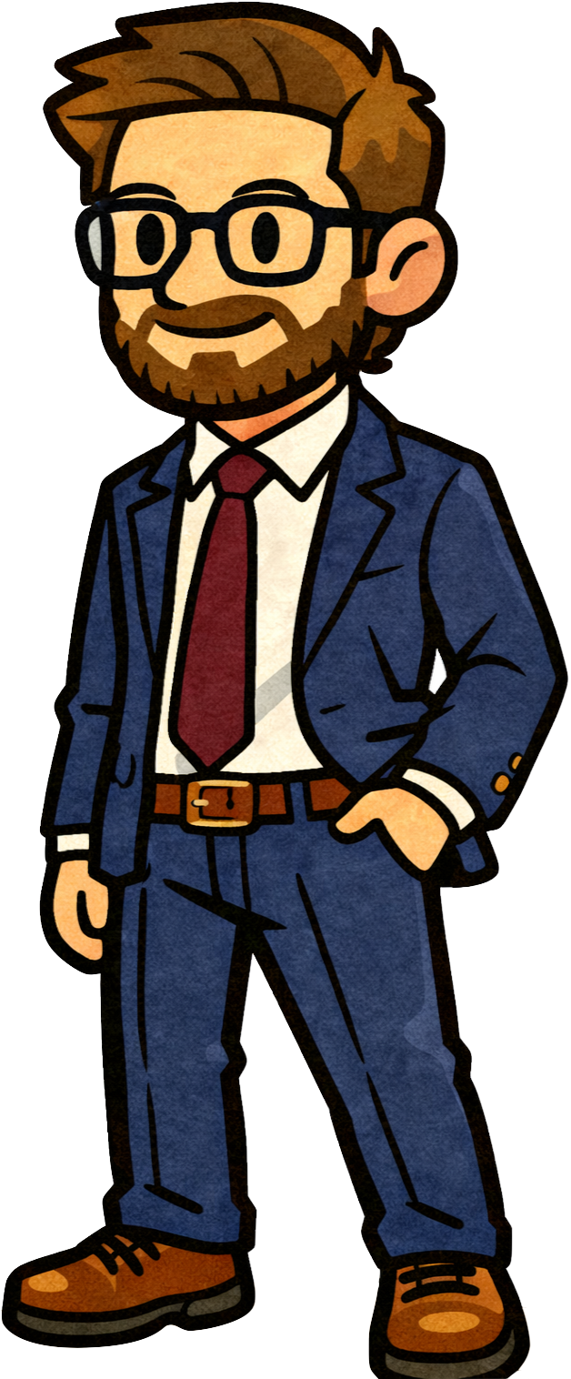



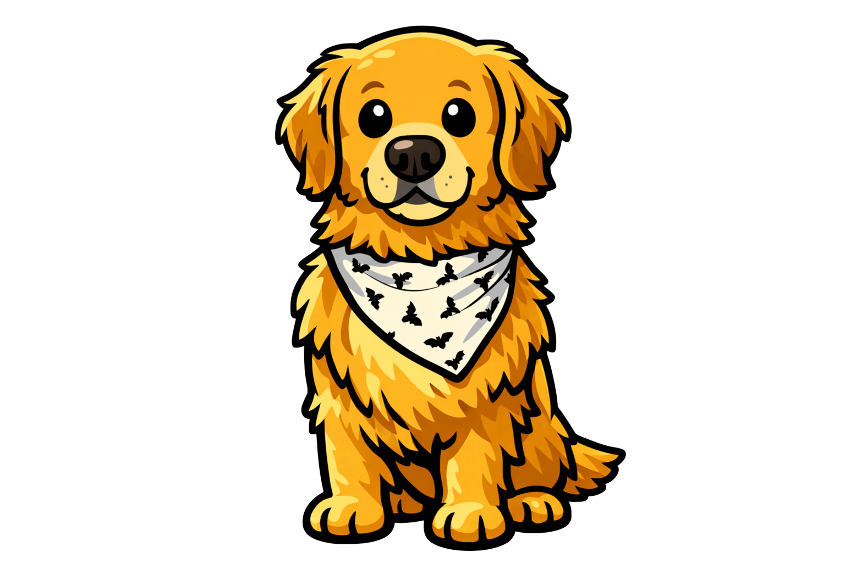
We made it and everyone is here!
Happy Birthday Gertie!

